Slide 1

Digital Logic Design

Slide 2
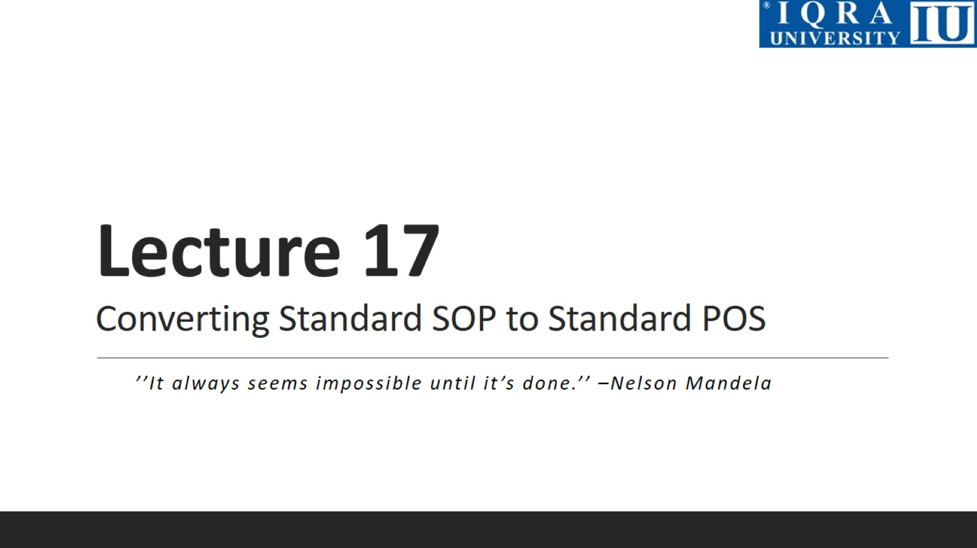
Lecture 17 Converting Standard SOP to Standard POS

Slide 3
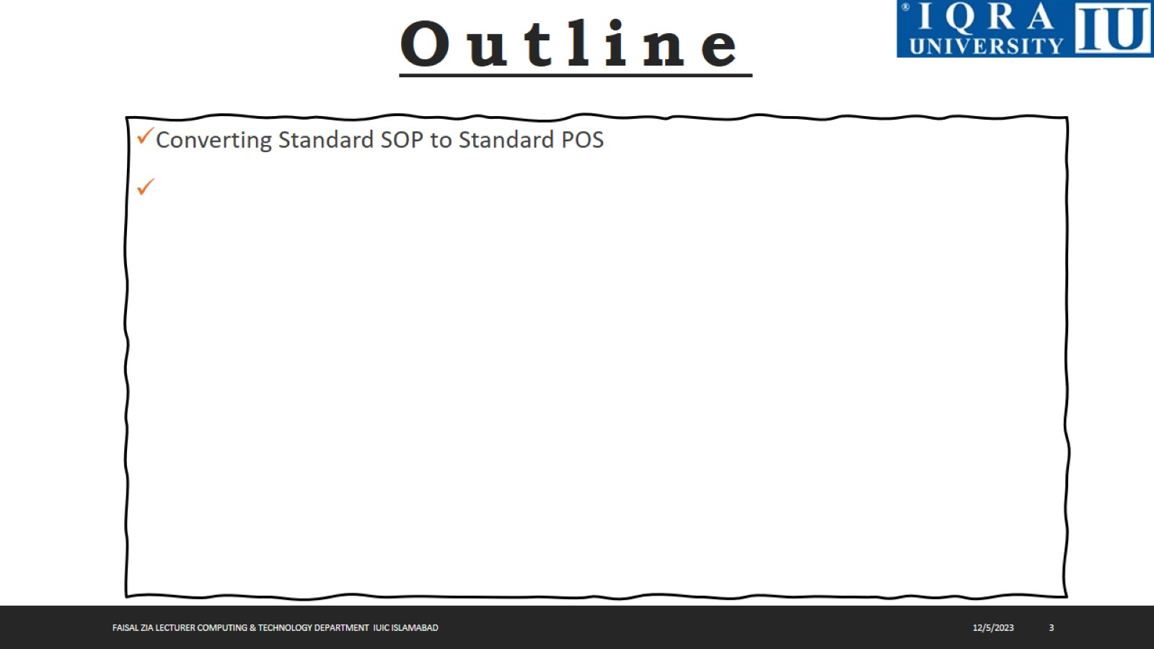

Slide 4
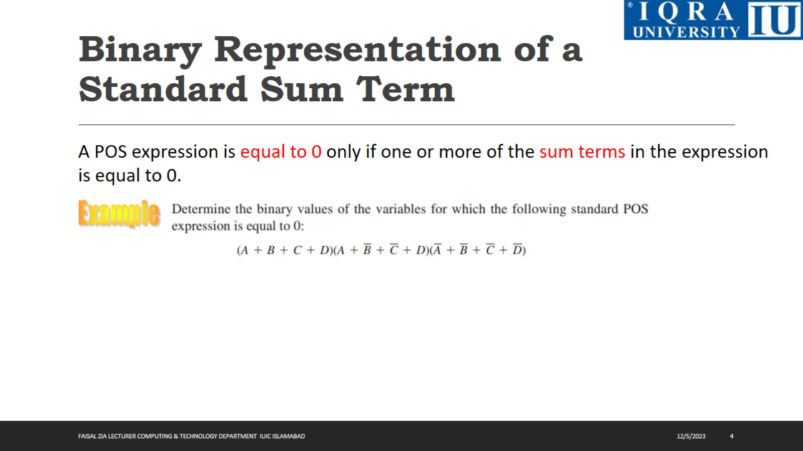
Binary Representation of a Standard Sum Term

Slide 5
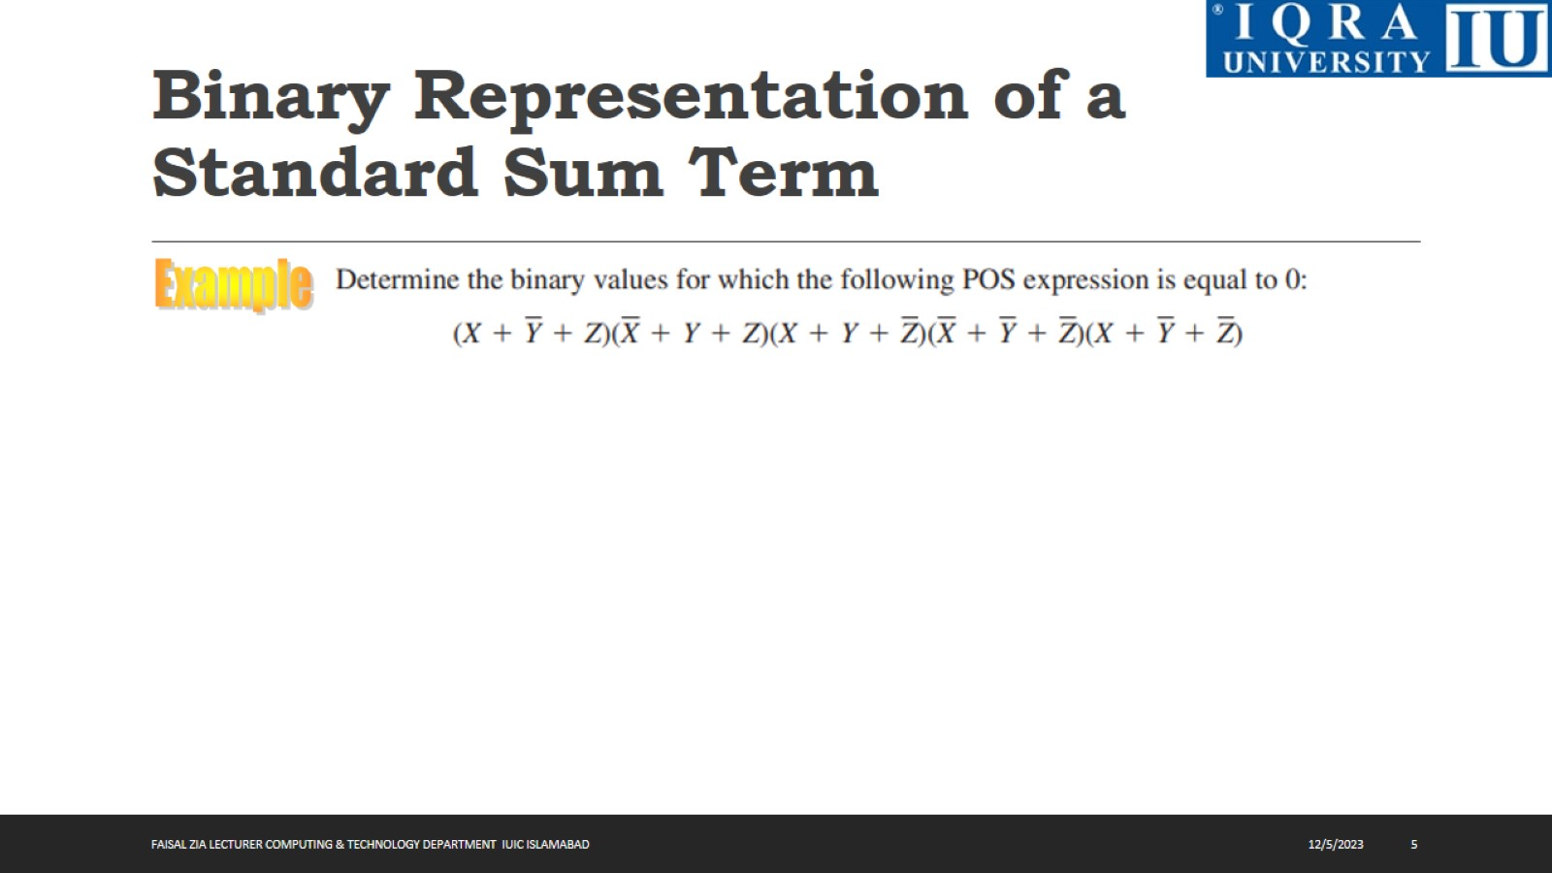
Binary Representation of a Standard Sum Term

Slide 6
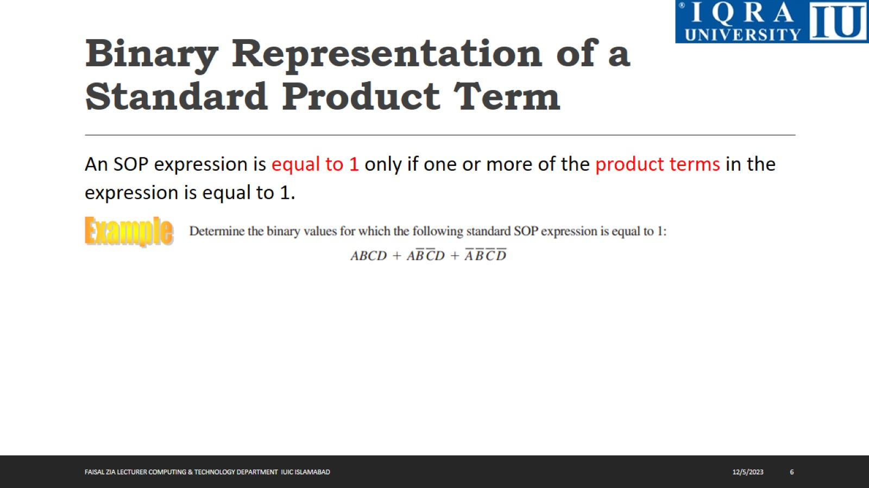
Binary Representation of a Standard Product Term

Slide 7
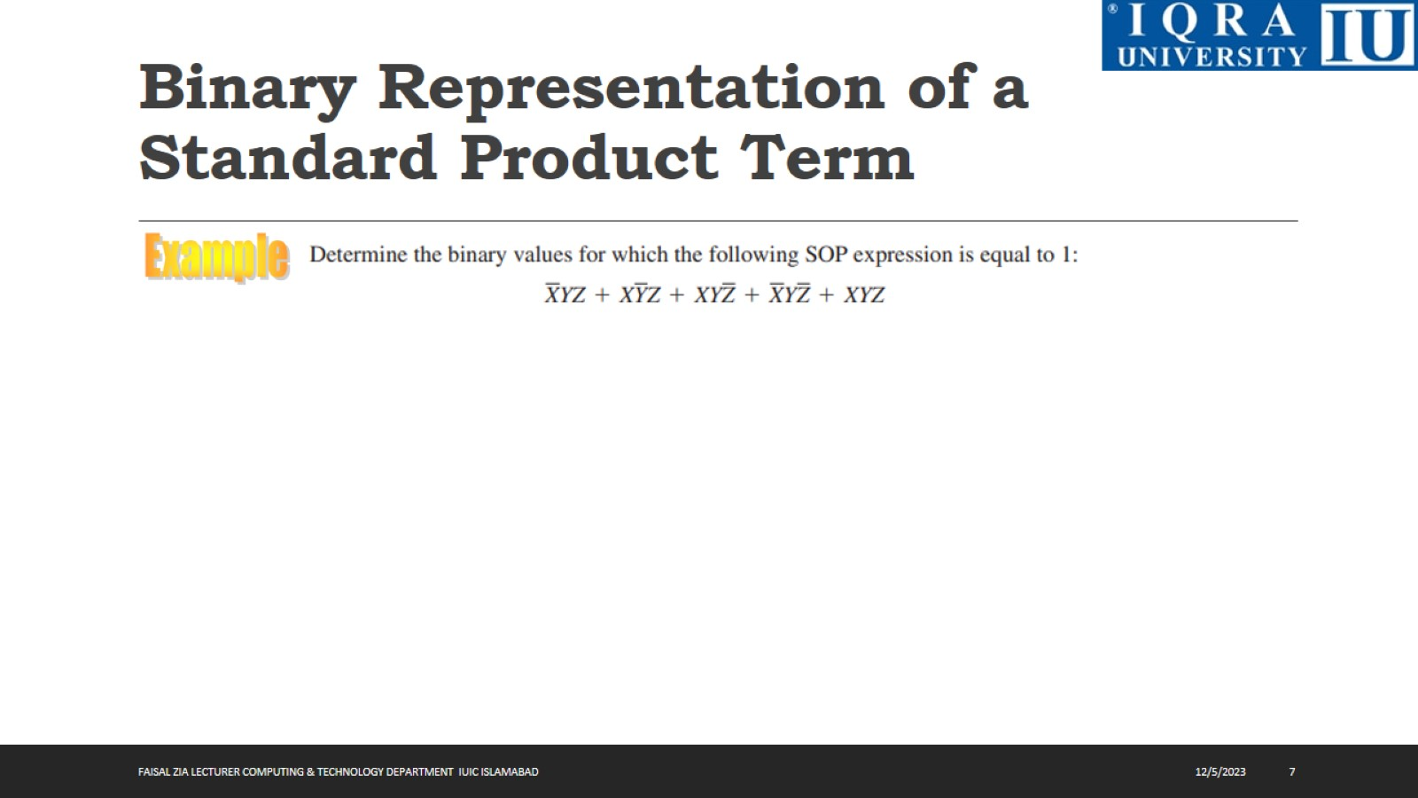
Binary Representation of a Standard Product Term

Slide 8
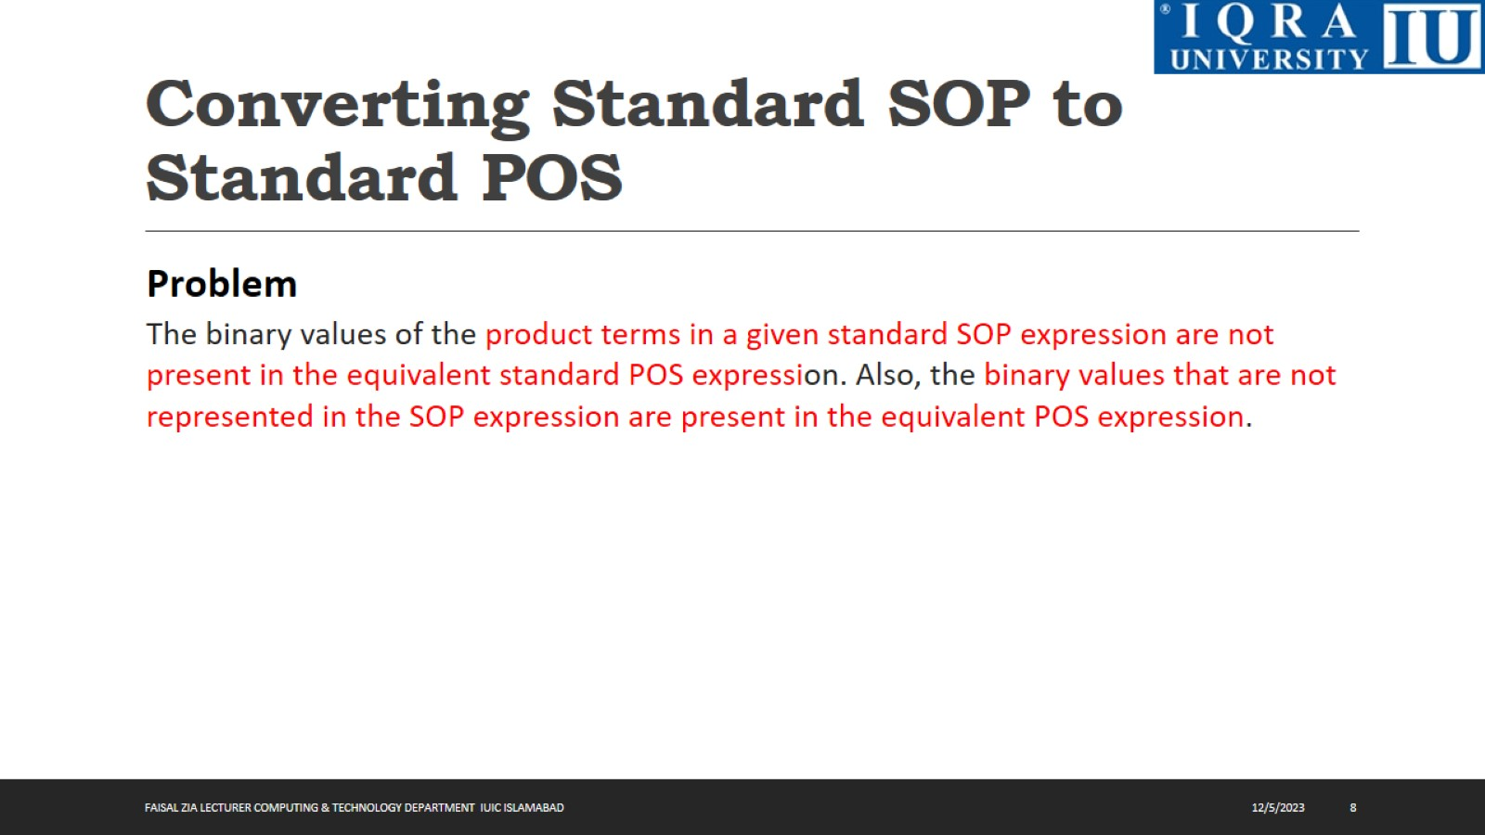
Converting Standard SOP to Standard POS

Slide 9
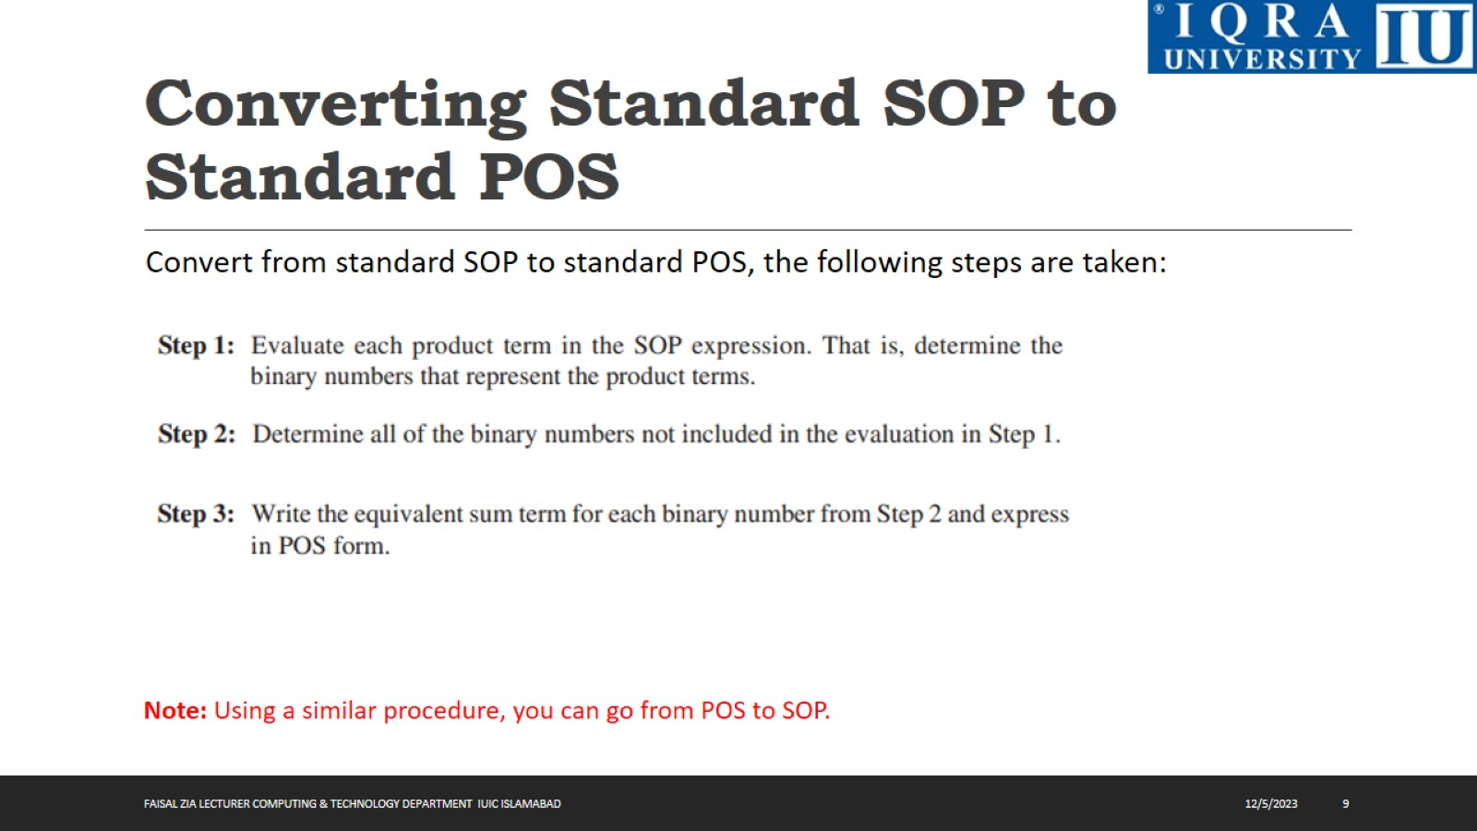
Converting Standard SOP to Standard POS

Slide 10
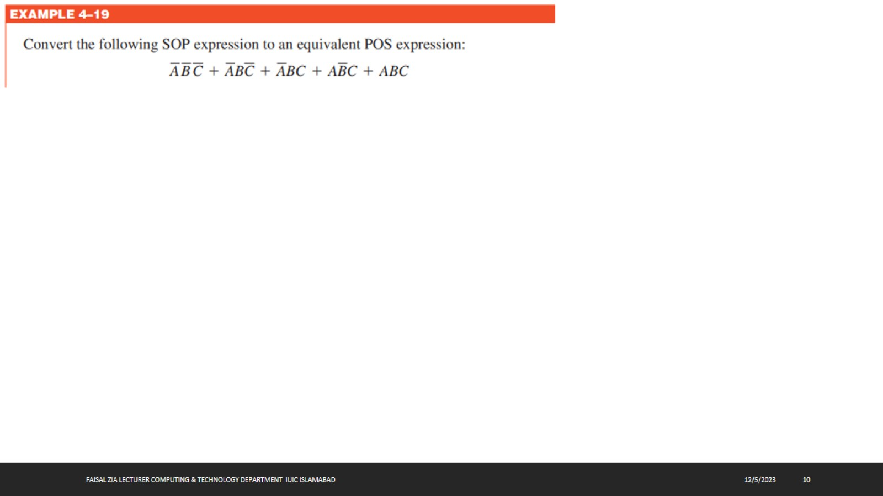

Slide 11
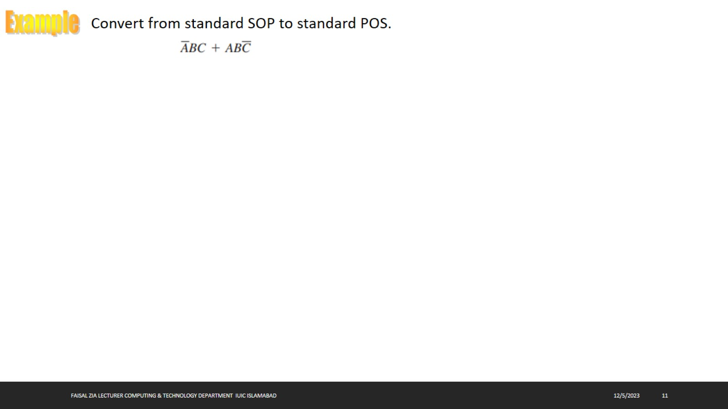

Slide 12
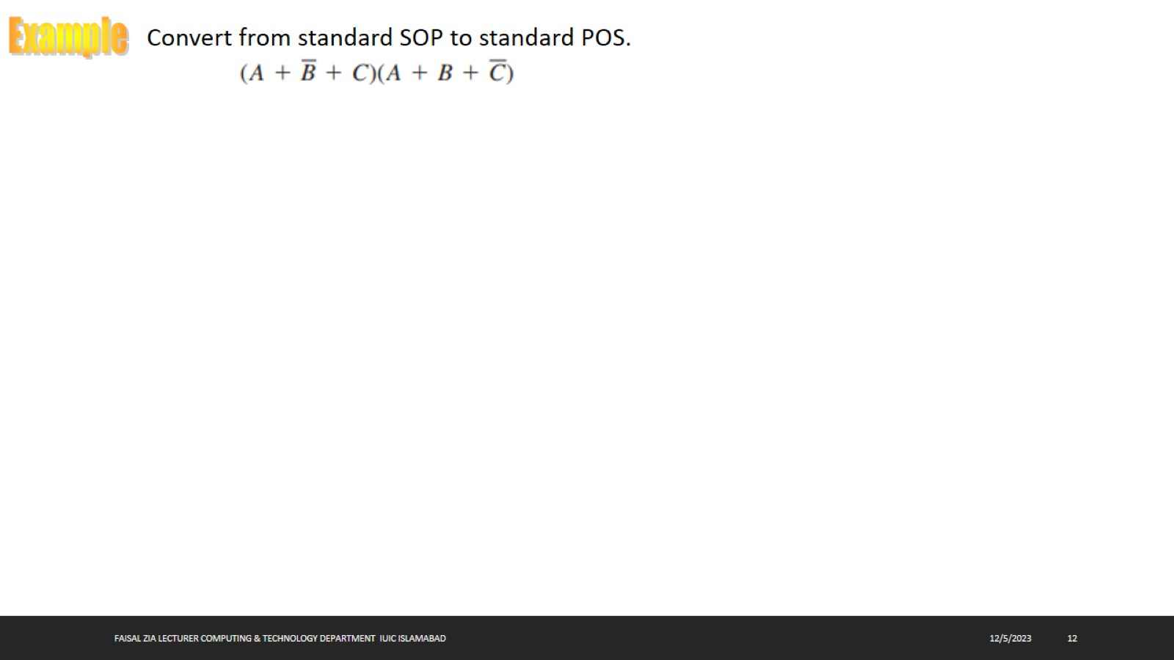

Slide 13
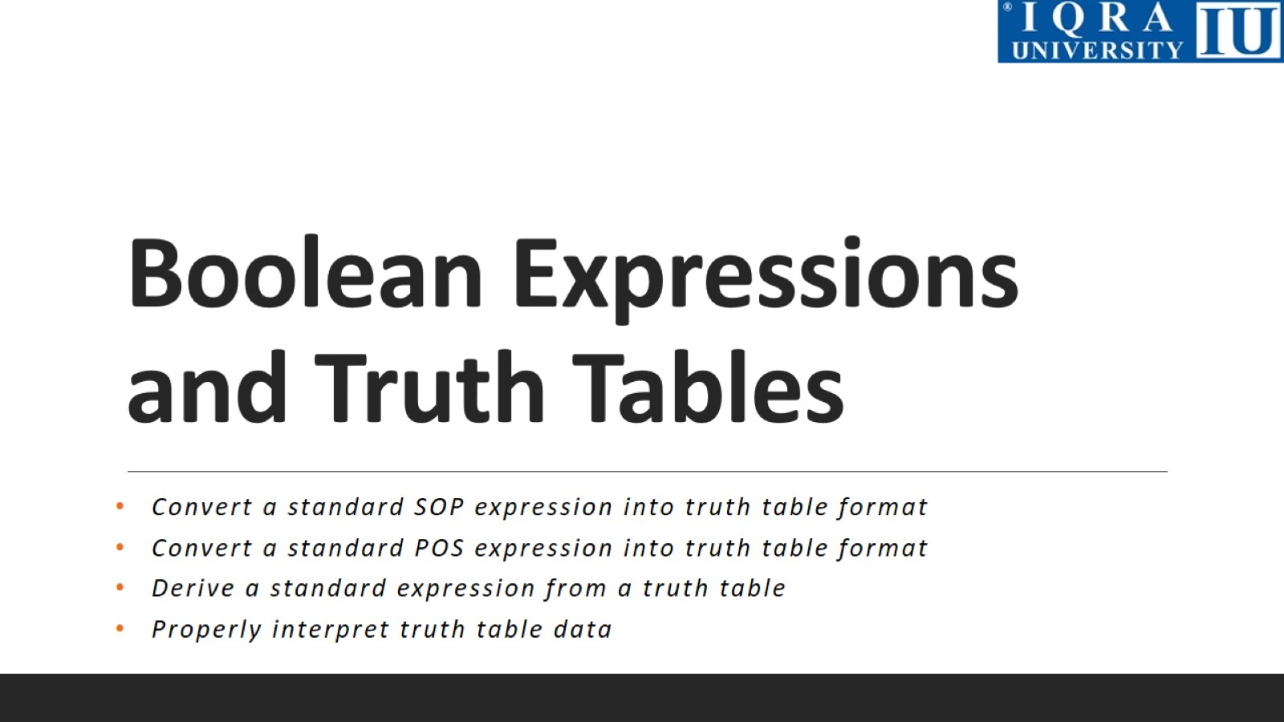
Boolean Expressions and Truth Tables

Slide 14
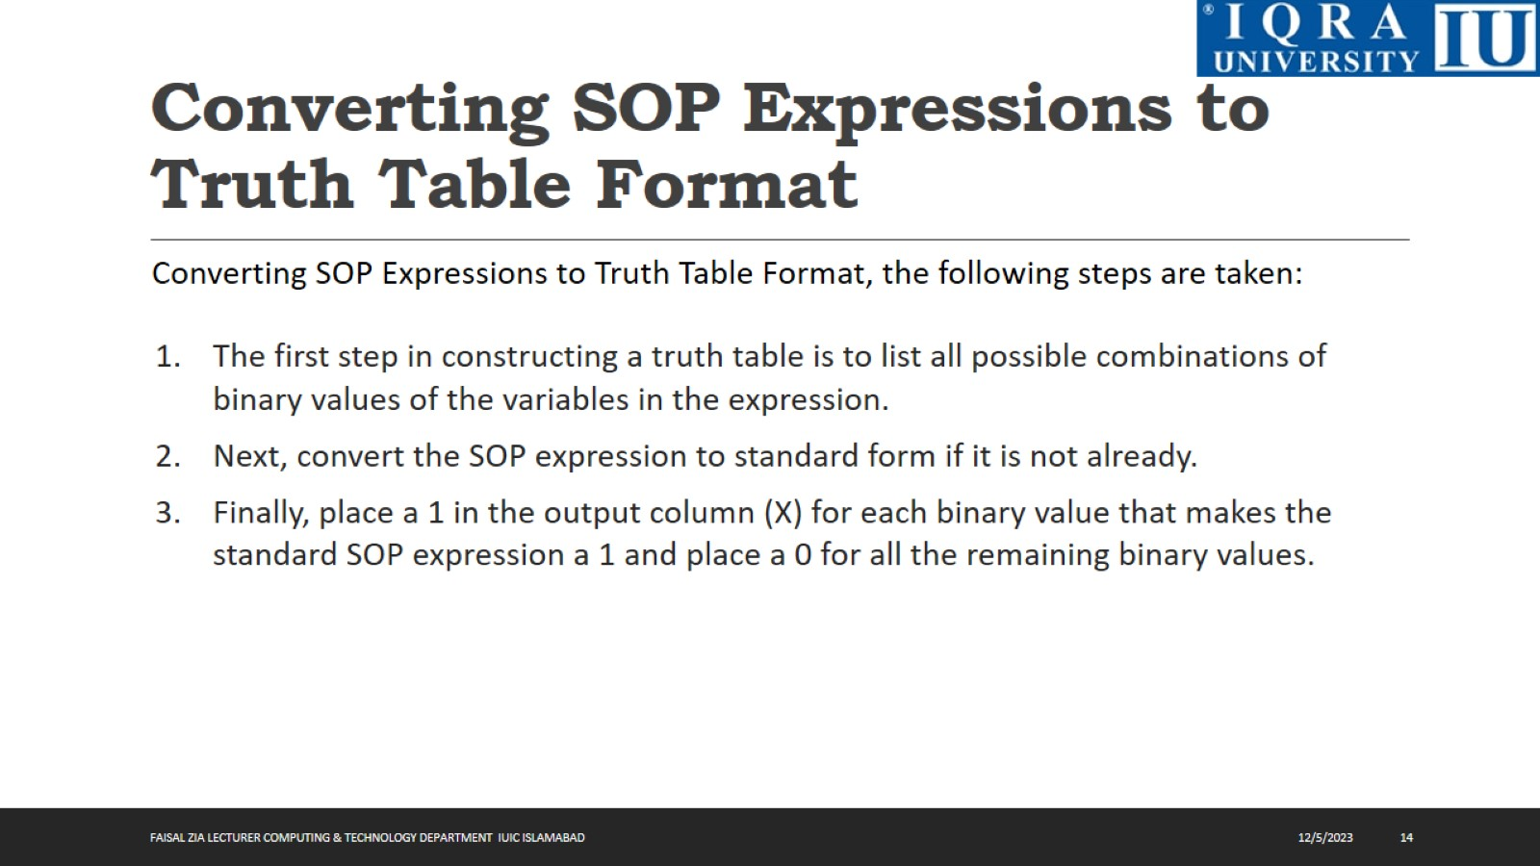
Converting SOP Expressions to Truth Table Format

Slide 15
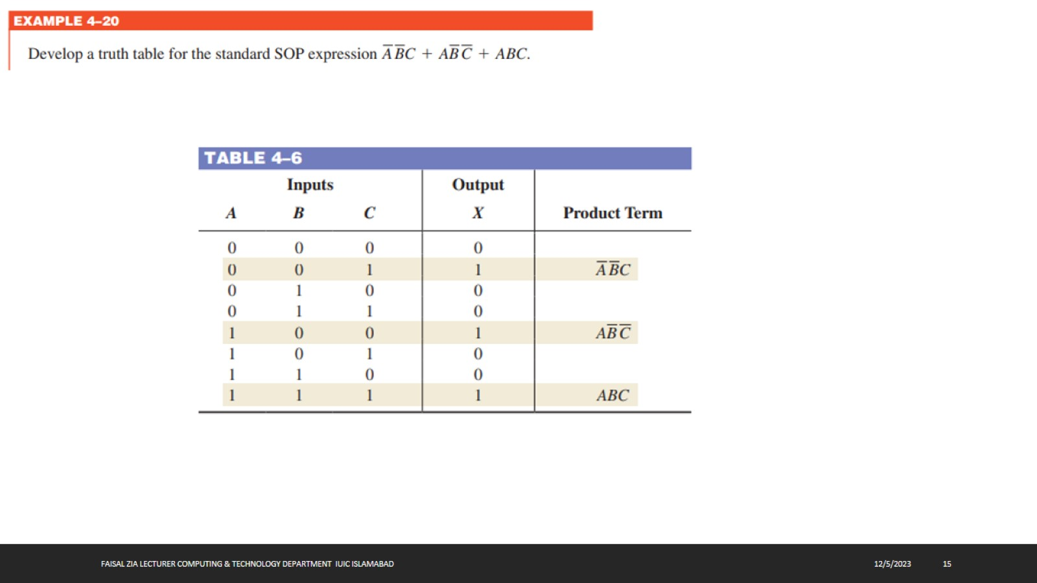

Slide 16
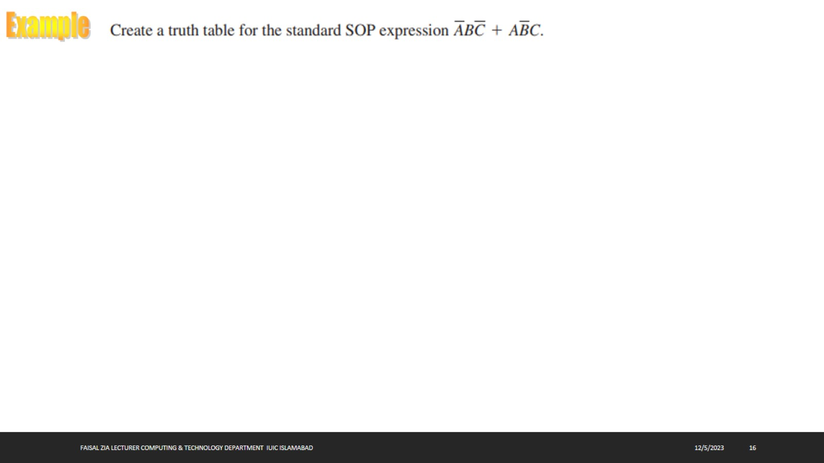

Slide 17
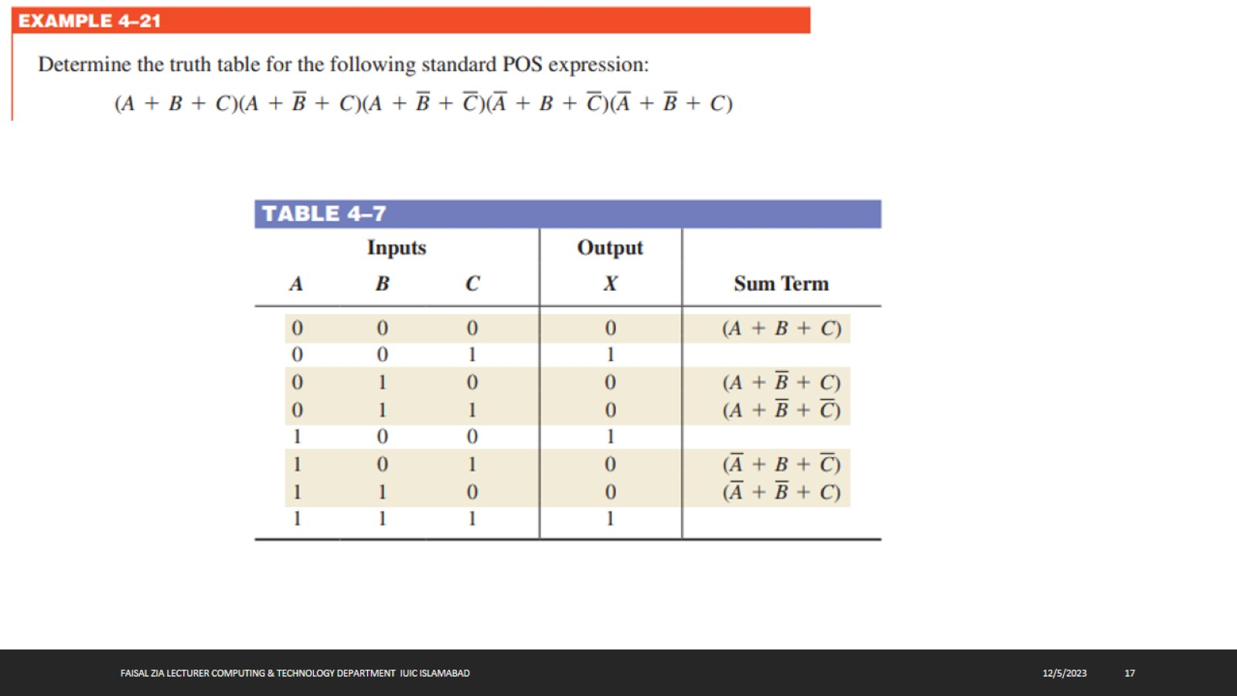

Slide 18
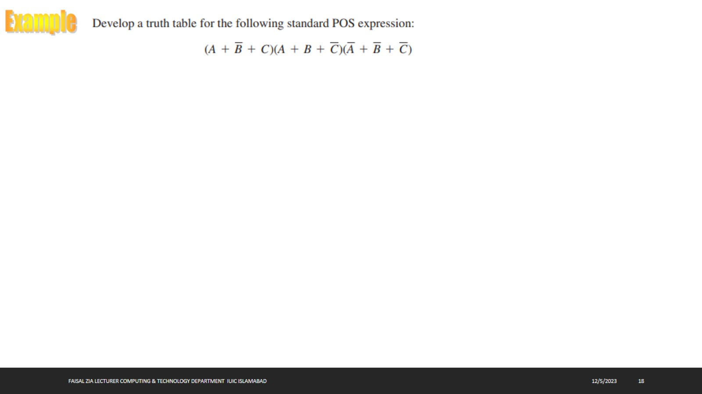

Slide 19
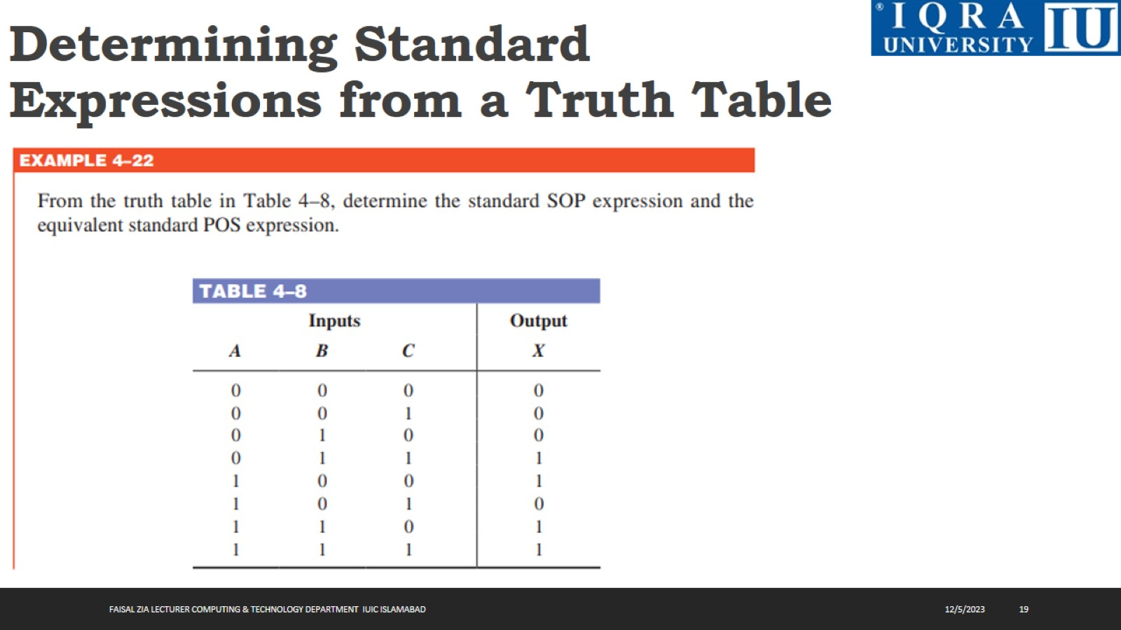
Determining Standard Expressions from a Truth Table

Slide 20
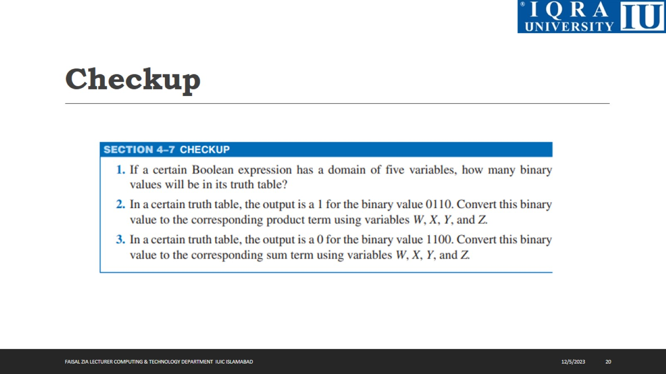
Checkup

Slide 21
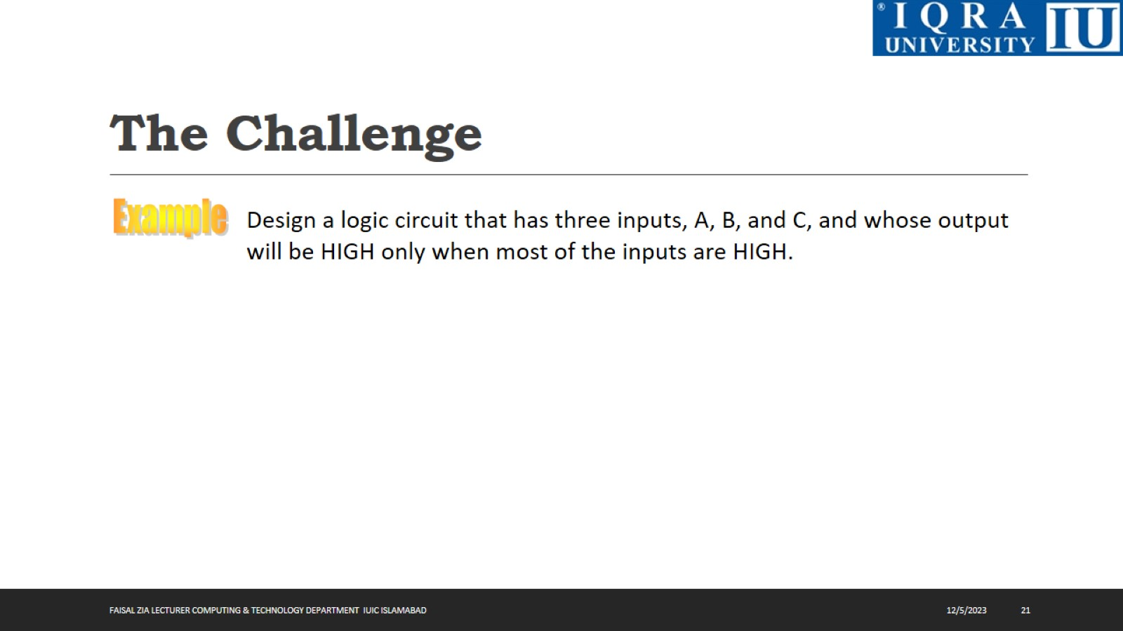
The Challenge

Slide 22
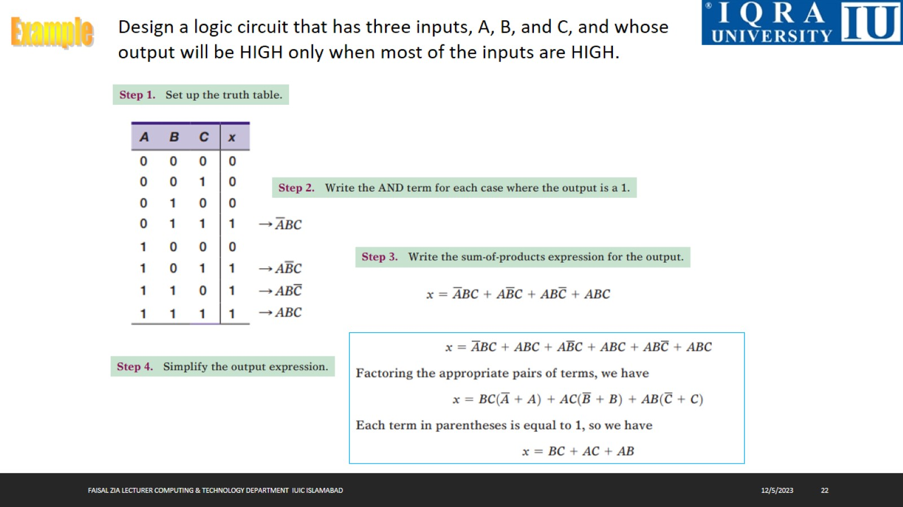

Slide 23
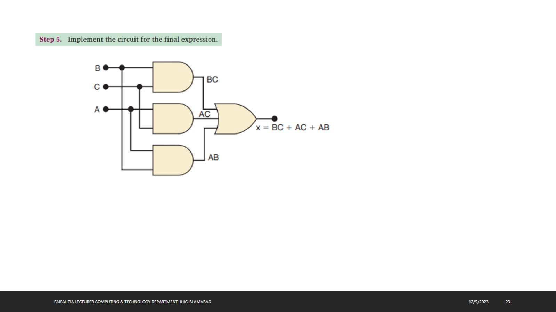

Slide 24
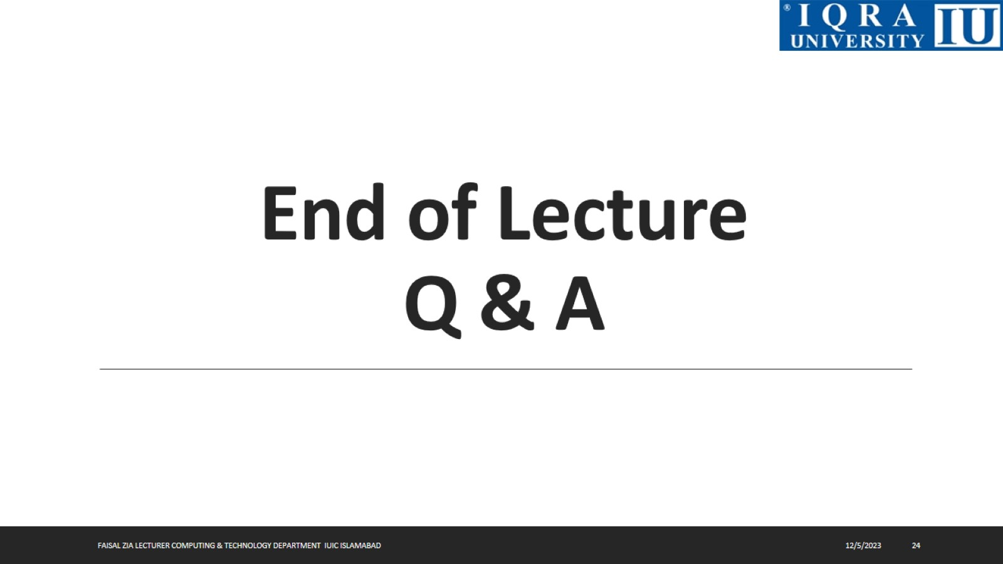
End of Lecture Q & A

